Slide 1

Slide 4- <number>

Slide 2
Chapter 4
Enhanced Entity-Relationship (EER) Modeling
Copyright © 2007 Ramez Elmasri and Shamkant B. Navathe

Slide 3
Chapter Outline
EER stands for Enhanced ER or Extended ER
EER Model Concepts
  Includes all modeling concepts of basic ER
  Additional concepts:
    subclasses/superclasses
    specialization/generalization
    categories (UNION types)
    attribute and relationship inheritance
  These are fundamental to conceptual modeling
The additional EER concepts are used to model applications more completely and more accurately
  EER includes some object-oriented concepts, such as inheritance
Slide 4- <number>

Slide 4
Subclasses and Superclasses (1)
An entity type may have additional meaningful subgroupings of its entities
  Example: EMPLOYEE may be further grouped into:
    SECRETARY, ENGINEER, TECHNICIAN, …
      Based on the EMPLOYEE’s Job
    MANAGER
      EMPLOYEEs who are managers
    SALARIED_EMPLOYEE, HOURLY_EMPLOYEE
      Based on the EMPLOYEE’s method of pay
EER diagrams extend ER diagrams to represent these additional subgroupings, called subclasses or subtypes
Slide 4- <number>

Slide 5

Subclasses and Superclasses
Slide 4- <number>

Slide 6
Subclasses and Superclasses (2)
Each of these subgroupings is a subset of EMPLOYEE entities
Each is called a subclass of EMPLOYEE
EMPLOYEE is the superclass for each of these subclasses
These are called superclass/subclass relationships:
  EMPLOYEE/SECRETARY
  EMPLOYEE/TECHNICIAN
  EMPLOYEE/MANAGER
  …
Slide 4- <number>

Slide 7
Subclasses and Superclasses (3)
These are also called IS-A relationships
  SECRETARY IS-A EMPLOYEE, TECHNICIAN IS-A EMPLOYEE, ….
Note: An entity that is member of a subclass represents the same real-world entity as some member of the superclass:
  The subclass member is the same entity in a distinct specific role
  An entity cannot exist in the database merely by being a member of a subclass; it must also be a member of the superclass
  A member of the superclass can be optionally included as a member of any number of its subclasses
Slide 4- <number>

Slide 8
Subclasses and Superclasses (4)
Examples:
  A salaried employee who is also an engineer belongs to the two subclasses:
    ENGINEER, and
    SALARIED_EMPLOYEE
  A salaried employee who is also an engineering manager belongs to the three subclasses:
    MANAGER,
    ENGINEER, and
    SALARIED_EMPLOYEE
It is not necessary that every entity in a superclass be a member of some subclass
Slide 4- <number>

Slide 9

Representing Specialization in EER Diagrams
Slide 4- <number>

Slide 10
Attribute Inheritance in Superclass / Subclass Relationships
An entity that is member of a subclass inherits
  All attributes of the entity as a member of the superclass
  All relationships of the entity as a member of the superclass
Example:
  In the previous slide, SECRETARY (as well as TECHNICIAN and ENGINEER) inherit the attributes Name, SSN, …, from EMPLOYEE
  Every SECRETARY entity will have values for the inherited attributes
Slide 4- <number>

Slide 11
Specialization (1)
Specialization is the process of defining a set of subclasses of a superclass
The set of subclasses is based upon some distinguishing characteristics of the entities in the superclass
  Example: {SECRETARY, ENGINEER, TECHNICIAN} is a specialization of EMPLOYEE based upon job type.
    May have several specializations of the same superclass
Slide 4- <number>

Slide 12
Specialization (2)
Example: Another specialization of EMPLOYEE based on method of pay is {SALARIED_EMPLOYEE, HOURLY_EMPLOYEE}.
  Superclass/subclass relationships and specialization can be diagrammatically represented in EER diagrams
  Attributes of a subclass are called specific or local attributes.
    For example, the attribute TypingSpeed of SECRETARY
  The subclass can also participate in specific relationship types.
    For example, a relationship BELONGS_TO of HOURLY_EMPLOYEE
Slide 4- <number>

Slide 13
Specialization (3)
Slide 4- <number>

Slide 14
Generalization
Generalization is the reverse of the specialization process
Several classes with common features are generalized into a superclass;
  original classes become its subclasses
Example: CAR, TRUCK generalized into VEHICLE;
  both CAR, TRUCK become subclasses of the superclass VEHICLE.
  We can view {CAR, TRUCK} as a specialization of VEHICLE
  Alternatively, we can view VEHICLE as a generalization of CAR and TRUCK
Slide 4- <number>

Slide 15

Generalization (2)
Slide 4- <number>

Slide 16
Generalization and Specialization (1)
Diagrammatic notation are sometimes used to distinguish between generalization and specialization
  Arrow pointing to the generalized superclass represents a generalization
  Arrows pointing to the specialized subclasses represent a specialization
  We do not use this notation because it is often subjective as to which process is more appropriate for a particular situation
  We advocate not drawing any arrows
Slide 4- <number>

Slide 17
Generalization and Specialization (2)
Data Modeling with Specialization and Generalization
  A superclass or subclass represents a collection (or set or grouping) of entities
  It also represents a particular type of entity
  Shown in rectangles in EER diagrams (as are entity types)
  We can call all entity types (and their corresponding collections) classes, whether they are entity types, superclasses, or subclasses
Slide 4- <number>

Slide 18
Constraints on Specialization and Generalization (1)
If we can determine exactly those entities that will become members of each subclass by a condition, the subclasses are called predicate-defined (or condition-defined) subclasses
  Condition is a constraint that determines subclass members
  Display a predicate-defined subclass by writing the predicate condition next to the line attaching the subclass to its superclass
Slide 4- <number>

Slide 19
Constraints on Specialization and Generalization (2)
If all subclasses in a specialization have membership condition on same attribute of the superclass, specialization is called an attribute-defined specialization
  Attribute is called the defining attribute of the specialization
  Example: JobType is the defining attribute of the specialization {SECRETARY, TECHNICIAN, ENGINEER} of EMPLOYEE
If no condition determines membership, the subclass is called user-defined
  Membership in a subclass is determined by the database users by applying an operation to add an entity to the subclass
  Membership in the subclass is specified individually for each entity in the superclass by the user
Slide 4- <number>

Slide 20
Displaying an attribute-defined specialization in EER diagrams
Slide 4- <number>

Slide 21
Constraints on Specialization and Generalization (3)
Two basic constraints can apply to a specialization/generalization:
  Disjointness Constraint:
  Completeness Constraint:
Slide 4- <number>

Slide 22
Constraints on Specialization and Generalization (4)
Disjointness Constraint:
  Specifies that the subclasses of the specialization must be disjoint:
    an entity can be a member of at most one of the subclasses of the specialization
  Specified by d in EER diagram
  If not disjoint, specialization is overlapping:
    that is the same entity may be a member of more than one subclass of the specialization
  Specified by o in EER diagram
Slide 4- <number>

Slide 23
Constraints on Specialization and Generalization (5)
Completeness Constraint:
  Total specifies that every entity in the superclass must be a member of some subclass in the specialization/generalization
  Shown in EER diagrams by a double line
  Partial allows an entity not to belong to any of the subclasses
  Shown in EER diagrams by a single line
Slide 4- <number>

Slide 24
Constraints on Specialization and Generalization (6)
Hence, we have four types of specialization/generalization:
  Disjoint, total
  Disjoint, partial
  Overlapping, total
  Overlapping, partial
Note: Generalization usually is total because the superclass is derived from the subclasses.
Slide 4- <number>

Slide 25
Example of disjoint partial Specialization
Slide 4- <number>

Slide 26

Example of overlapping total Specialization
Slide 4- <number>

Slide 27
Specialization/Generalization Hierarchies, Lattices & Shared Subclasses (1)
A subclass may itself have further subclasses specified on it
  forms a hierarchy or a lattice
Hierarchy has a constraint that every subclass has only one superclass (called single inheritance); this is basically a tree structure
In a lattice, a subclass can be subclass of more than one superclass (called multiple inheritance)
Slide 4- <number>

Slide 28

Shared Subclass “Engineering_Manager”
Slide 4- <number>

Slide 29
Specialization/Generalization Hierarchies, Lattices & Shared Subclasses (2)
In a lattice or hierarchy, a subclass inherits attributes not only of its direct superclass, but also of all its predecessor superclasses
A subclass with more than one superclass is called a shared subclass (multiple inheritance)
Can have:
  specialization hierarchies or lattices, or
  generalization hierarchies or lattices,
  depending on how they were derived
We just use specialization (to stand for the end result of either specialization or generalization)
Slide 4- <number>

Slide 30
Specialization/Generalization Hierarchies, Lattices & Shared Subclasses (3)
In specialization, start with an entity type and then define subclasses of the entity type by successive specialization
  called a top down conceptual refinement process
In generalization, start with many entity types and generalize those that have common properties
  Called a bottom up conceptual synthesis process
In practice, a combination of both processes is usually employed
Slide 4- <number>

Slide 31

Specialization / Generalization Lattice Example (UNIVERSITY)
Slide 4- <number>

Slide 32
Categories (UNION TYPES) (1)
All of the superclass/subclass relationships we have seen thus far have a single superclass
A shared subclass is a subclass in:
  more than one distinct superclass/subclass relationships
  each relationships has a single superclass
  shared subclass leads to multiple inheritance
In some cases, we need to model a single superclass/subclass relationship with more than one superclass
Superclasses can represent different entity types
Such a subclass is called a category or UNION TYPE
Slide 4- <number>

Slide 33
Categories (UNION TYPES) (2)
Example: In a database for vehicle registration, a vehicle owner can be a PERSON, a BANK (holding a lien on a vehicle) or a COMPANY.
  A category (UNION type) called OWNER is created to represent a subset of the union of the three superclasses COMPANY, BANK, and PERSON
  A category member must exist in at least one of its superclasses
Difference from shared subclass, which is a:
  subset of the intersection of its superclasses
  shared subclass member must exist in all of its superclasses
Slide 4- <number>

Slide 34
Formal Definitions of EER Model (1)
Class C:
  A type of entity with a corresponding set of entities:
    could be entity type, subclass, superclass, or category
Note: The definition of relationship type in ER/EER should have 'entity type' replaced with 'class‘ to allow relationships among classes in general
Subclass S is a class whose:
    Type inherits all the attributes and relationship of a class C
    Set of entities must always be a subset of the set of entities of the other class C
      S ⊆ C
    C is called the superclass of S
    A superclass/subclass relationship exists between S and C
Slide 4- <number>

Slide 35
Formal Definitions of EER Model (2)
Specialization Z: Z = {S1, S2,…, Sn} is a set of subclasses with same superclass G; hence, G/Si is a superclass relationship for i = 1, …., n.
  G is called a generalization of the subclasses {S1, S2,…, Sn}
  Z is total if we always have:
    S1 ∪ S2 ∪ … ∪ Sn = G;
    Otherwise, Z is partial.
  Z is disjoint if we always have:
    Si ∩ Sj empty-set for i ≠ j;
  Otherwise, Z is overlapping.
Slide 4- <number>

Slide 36
Formal Definitions of EER Model (3)
Subclass S of C is predicate defined if predicate (condition) p on attributes of C is used to specify membership in S;
  that is, S = C[p], where C[p] is the set of entities in C that satisfy condition p
A subclass not defined by a predicate is called user-defined
Attribute-defined specialization: if a predicate A = ci (where A is an attribute of G and ci is a constant value from the domain of A) is used to specify membership in each subclass Si in Z
  Note: If ci ≠ cj for i ≠ j, and A is single-valued, then the attribute-defined specialization will be disjoint.
Slide 4- <number>

Slide 37
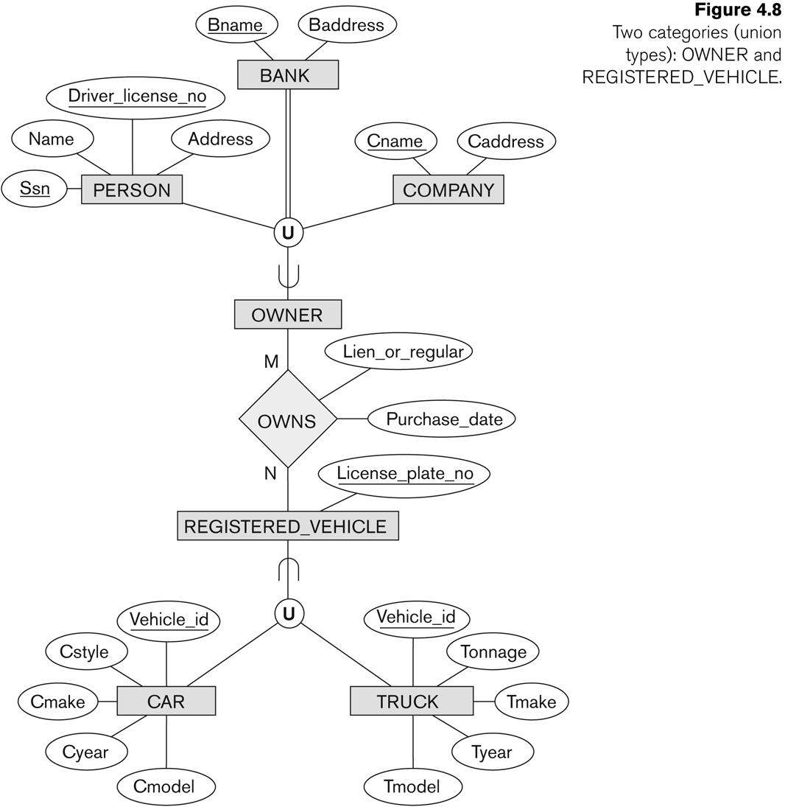
Two categories (UNION types): OWNER, REGISTERED_VEHICLE
Slide 4- <number>

Slide 38
Slide 4- <number>

Slide 39
Formal Definitions of EER Model (4)
Category or UNION type T
  A class that is a subset of the union of n defining superclasses
  D1, D2,…Dn, n>1:
    T ⊆ (D1 ∪ D2 ∪ … ∪ Dn)
  Can have a predicate pi on the attributes of Di to specify entities of Di that are members of T.
  If a predicate is specified on every Di: T = (D1[p1] ∪ D2[p2] ∪…∪ Dn[pn])
Slide 4- <number>

Slide 40
Alternative diagrammatic notations
ER/EER diagrams are a specific notation for displaying the concepts of the model diagrammatically
DB design tools use many alternative notations for the same or similar concepts
One popular alternative notation uses UML class diagrams
see next slides for UML class diagrams and other alternative notations
Slide 4- <number>

Slide 41
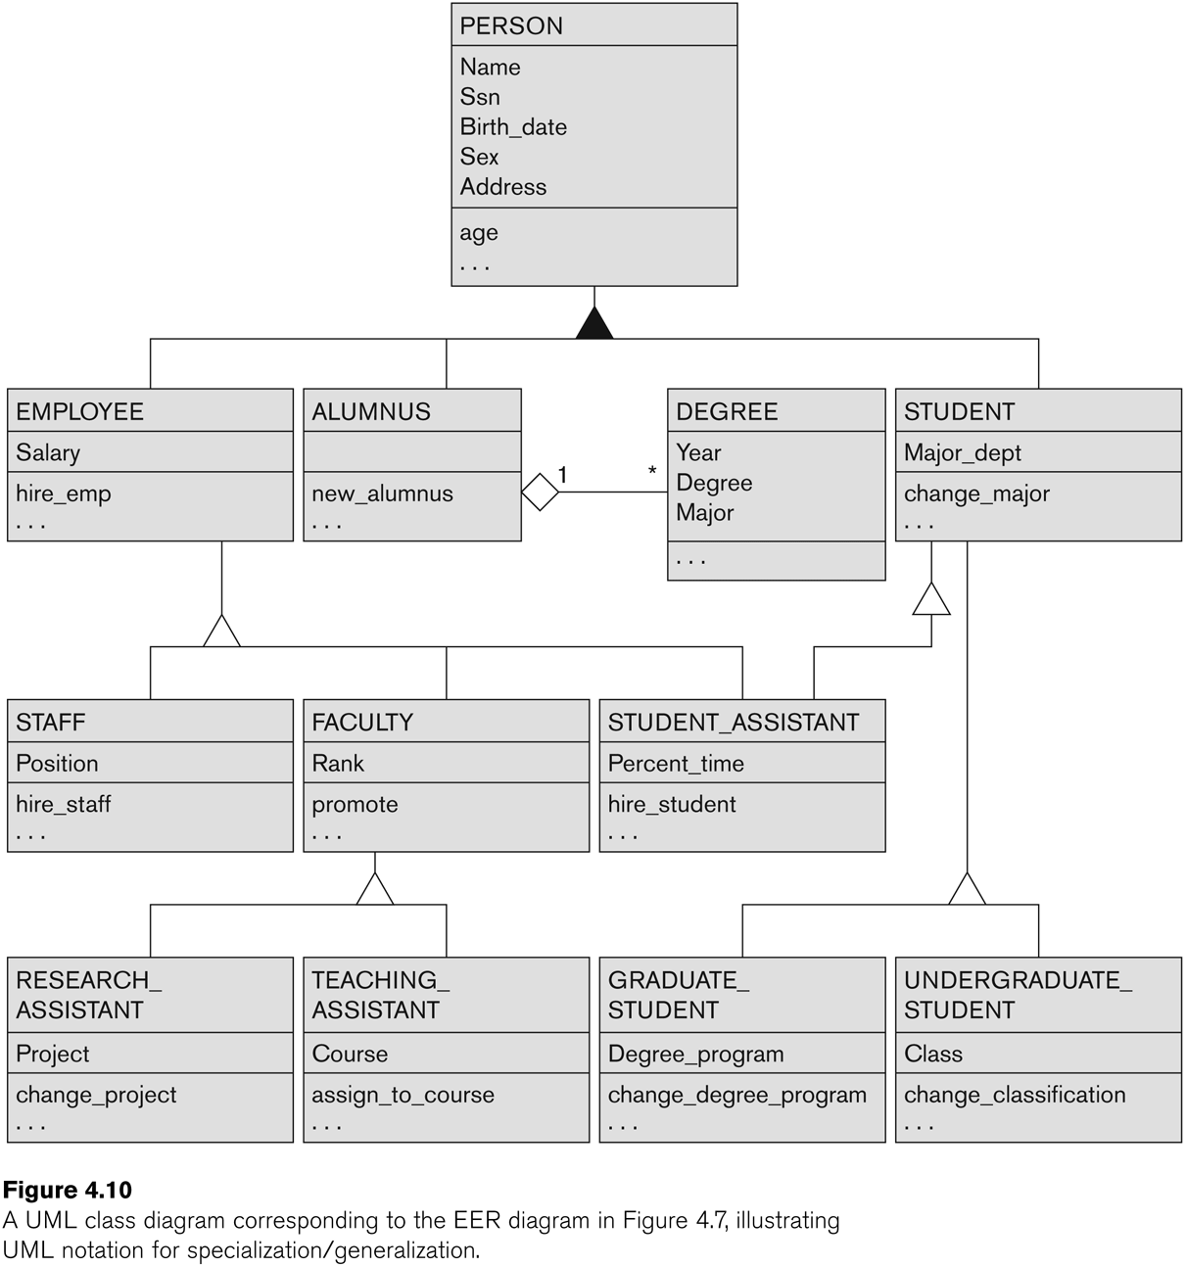
UML Example for Displaying Specialization / Generalization
Slide 4- <number>

Slide 42
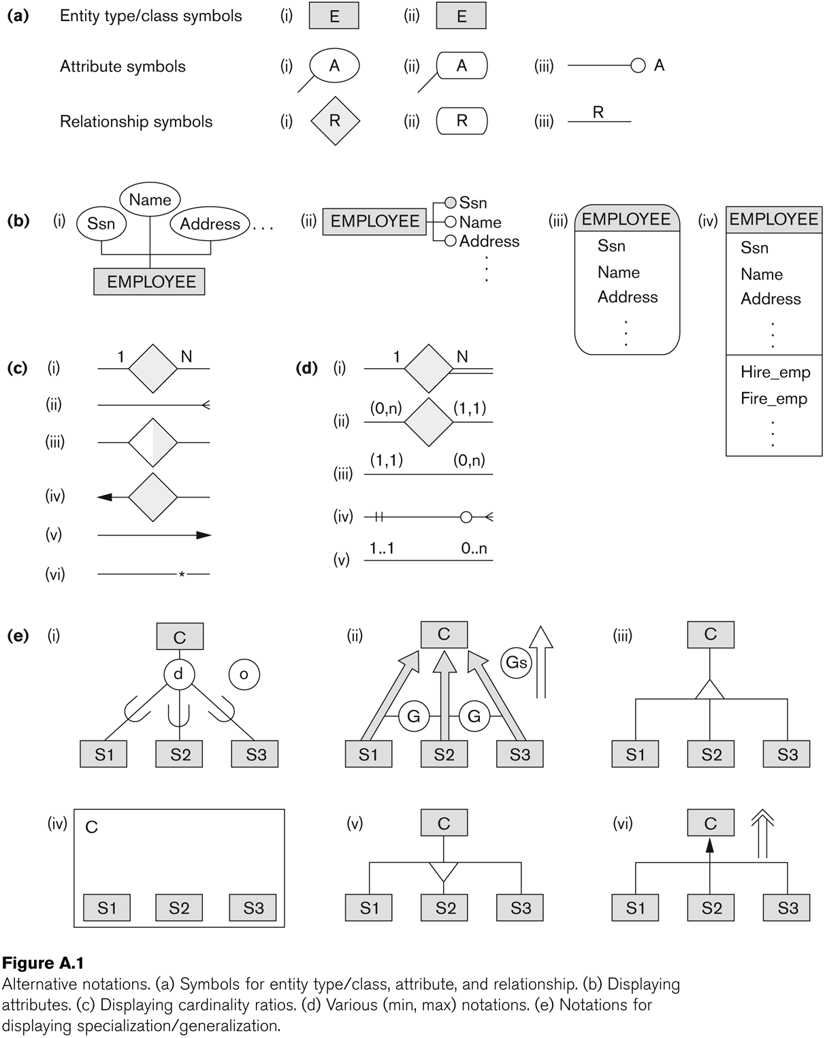
Alternative Diagrammatic Notations
Slide 4- <number>

Slide 43
General Conceptual Modeling Concepts
GENERAL DATA ABSTRACTIONS
  CLASSIFICATION and INSTANTIATION
  AGGREGATION and ASSOCIATION (relationships)
  GENERALIZATION and SPECIALIZATION
  IDENTIFICATION
CONSTRAINTS
  CARDINALITY (Min and Max)
  COVERAGE (Total vs. Partial, and Exclusive (disjoint) vs. Overlapping)
Slide 4- <number>

Slide 44
Ontologies
Use conceptual modeling and other tools to develop “a specification of a conceptualization”
  Specification refers to the language and vocabulary (data model concepts) used
  Conceptualization refers to the description (schema) of the concepts of a particular field of knowledge and the relationships among these concepts
Many medical, scientific, and engineering ontologies are being developed as a means of standardizing concepts and terminology
Slide 4- <number>

Slide 45
Summary
Introduced the EER model concepts
  Class/subclass relationships
  Specialization and generalization
  Inheritance
These augment the basic ER model concepts introduced in Chapter 3
EER diagrams and alternative notations were presented
Slide 4- <number>

